Slide 1

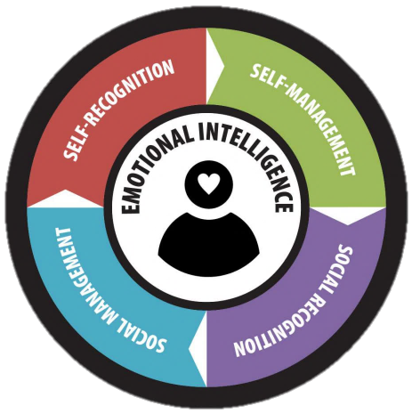
DISC & EIQ-2
Understanding Behavior & Emotional Intelligence
for Effective Communication

Slide 2
DISC
Understanding Behavior
Notes:
Today is all about exploring how our behaviors show up. The purpose of this course is to help you create better communication with those around you. Our hope is that you will use what we learn today to create better relationships by understanding yourself and others in a new way.

Slide 3
The Platinum Rule®
People generally make the mistake of assuming that others interact and think the same way they do
The Golden Rule: treating others the way you would like to be treated
The Platinum Rule®: treat others the way THEY want to be treated.
Notes:
SAY: People generally make the mistake of assuming that others interact and think the same way they do.
ASK: How many of you have heard of the Golden Rule? What is it?
SAY: While that is a great rule to live by much of the time, it doesn’t always work with communication! Instead, we ask you to consider Dr. Tony Alessandra’s Platinum Rule® - treat others the way THEY want to be treated to communicate as effectively as possible. To help us know what other people want and need, we must seek to understand them. DISC is a way to help us do just that.

Slide 4
What is DISC?
DISC is a simple, practical, easy to remember and universally applicable model.
DISC is:
needs-motivated, observable behavior and emotion; it is a combination of nature (inherent) and nurture (learned).
DISC is NOT:
a measure of intelligence, skills, education or experience, or an indicator of values
Notes:
Review slide

Slide 5
Natural and Adapted
Natural Style: This is the self-perception of the “real you” and the instinctive behaviors. These are behaviors the person is most likely to exhibit when in situations they perceive as being stressful or in situations where they can simply do as they choose without having to consider anyone else. The Natural Style tends to be fairly consistent even in different environments.
Adapted Style: This is the self-perception of the way people believe they need to behave in their current environment to be successful. This behavior may change in different environments, situations and roles.
KnowDISC: 4 short videos with characteristics and insights about each of the styles
Notes:
The DISC report measures two different parts of our behavioral style – the Natural and the Adapted.
Review slide

Slide 6
Four Core Styles
Conscientious
Dominance
Procedures and Constraints
Problems and Challenges
Steadiness
Influence
Pace and Consistency
People and Contacts
Notes:
There are four styles that make up DISC: D – Dominance I – Influence S – Steadiness C – Conscientious While there are four primary styles most people are a blend of styles. Each style is characterized by specific areas of focus and specific behavioral tendencies.
Let’s look first at the areas of focus: D = Dominance How people address Problems and Challenges. I = Influence How people handle situations involving People and Contacts. S = Steadiness How people demonstrate Pace and Consistency. C = Conscientiousness How people react to Procedure and Constraints.
Now let’s look at behavioral tendencies.

Slide 7
Identifying the Four Styles
GUARDED
C
D
INDIRECT
DIRECT
S
I
OPEN
Notes:
Behavioral tendencies are measured through directness and openness.
D = Dominance Tends to be Direct and Guarded I = Influence Tends to be Direct and Open S = Steadiness Tends to be Indirect and Open* *The S style is open to others, but the true emotion of the style is concealed. It "appears" open, but it is not really open at all. C = Conscientious Tends to be Indirect and Guarded
Ask: What is the difference between someone who is direct or indirect? Possible Answers: Someone who is direct may say exactly what comes to mind. Someone who is indirect may take their time and think before they speak. What is the difference between someone who is guarded or open? Possible Answers: Guarded, keep things more to yourself. Open you express your thoughts and feelings to others. Is it easy to tell the difference between people who are direct/indirect or guarded/open?
There are two questions you can ask to easily identify what style you or others may be. • The first question is “are you more direct or indirect?” • The second question is to ask is “are you more guarded or open?” Through these two questions, you can determine likely placement of style on the quadrant based on observable behavior. Let’s try it for you to see how it works. Ask: Are you more direct or indirect? Using the scale of A - D on the screen, choose a letter based on your directness or indirectness. (pause) Now, are you more guarded or open? Using the scale of 1-4 on the screen, choose a number based on if you are more guarded or open. (pause) Say: Depending on the number and letter you chose, you are a D, an I, an S or a C. - 1-2 and a C-D then you are considered the D - 3-4 and C-D you are the I Style - 3-4 and A-B you are the S Style - 1-2 and A-B you are the C Style
1

Slide 8
Identifying the Four Styles
Analytical Systematic
Courteous Precise Focused Fact-Finder
Risk-Taker Direct
Forceful Self-Reliant Decisive Competitive
D
C
S
I
Calming Steady
Loyal Consistent
Relaxed Patient
Influential Trusting
Sociable Friendly Optimistic Enthusiastic
Notes:
Say: To help us create mental pictures and more clearly identify these styles, let’s examine some common behavioral observations for each style.
Facilitator Note: Ask a volunteer to read through descriptors as they come on screen.
Ask with each style reveal: When you hear those words, what kind of person comes to mind? How do they walk? How do they talk? What does their workspace look like? What value do they bring to our teams?
Ask: Can you see any descriptors that fit you? Do the descriptors match with the style you believed yourself to be a few minutes ago using the 2 questions?
Say: Each behavioral style brings unique abilities and no one style is better than another than another. Remember, most of us a blend of styles so it is important to be able to identify the most likely style based on observable behaviors to help us co
1

Slide 9
Greetings!
Notes:
Greet 2 people in the style of a D
Greet 2 other people in the style of an I
Greet 2 other people in the style of an S
Greet 2 other people in the style of an C
Which was most difficult? Which was easiest? Why?

Slide 10
Pace & Priority
Pace & Priority Challenge
Task
C
D
Pace Challenge
Slower
Faster
Priority Challenge
Priority Challenge
S
Pace Challenge
I
People
Pace & Priority Challenge
Notes:
Say: In addition to having differing focuses, behavioral tendencies and observable characteristics, each style also has a different pace and priority. These differences can be easily overlooked and can lead to challenges.
FACILITATOR NOTE: Click the first animation, Slower and Faster
Say: D& I and S & C have different paces: • D and I are faster paced • S and C are slower paced
FACILITATOR NOTE: Click the second animation, Task and People
D & C and S & I have different priorities: • D and C are task focused • I and S are people focused
Ask: What challenges can come from having different paces? What challenges can come from having different priorities?
Say: D & S and C & I have both Pace and Priority Challenges. Noting how pace and priority differ in our relationships is essential in creating understanding.

Slide 11
DISC Emotions
“D” Anger and Impatience | “I” Optimism and Trust | “S” Patience and Non-Expressive | “C” Fear and Concern
The higher the plotting point, the higher tendency the D will have a short fuse or be more impatient.
The lower the D, the more the person tends to be patient and slow to anger.
The higher the plotting point, the more the I person will look on the bright side and exhibit a high trust level.
The lower the I, the more the person tends to be pessimistic and exhibit a low level of trust.
The higher the plotting point, the more the S will avoid showing true emotions*. They appear “fine” and seem patient.
The lower the S, the more people hear and see emotions.
The higher the plotting point, the more the C will follow rules and need data and facts, proving the need to do things right and avoid being wrong.
The lower the C, the more likely the person is to take risks. Rules are merely guidelines.
*The high S appears open, but true emotions are concealed.
Notes:
In addition to these style indicators, each DISC style also expresses specific emotions.
Facilitator Note: Review each box for each style. D - anger and impatience I - optimism and trust S - patience and non-expressiveness C - fear and concern *Remember, the S style appears open with people, but the true emotion of the style is concealed.
Ask: Why is it important to know what emotions are associated to each style? Possible answers: We can be more aware of others challenges and how we can support, we can be more patient with others difficulties.

Slide 12
Adaptability
Highly adaptable people determine what types of behavior are most appropriate in specific situations.
Adaptability is important to all successful relationships.
No one style is naturally more adaptable than another.
Notes:
Adaptability is important to all successful relationships. No one style is naturally more adaptable than another. Highly adaptable people determine what types of behavior are most appropriate in specific situations.
Ask: What is adaptability? Possible answers: changing how we behave to be more like others, learning something new to be more responsive in change

Slide 13
Adaptability
Are they DIRECT or INDIRECT??
Are they GUARDED or OPEN?
Direct Style: D or I Enthusiastic, competitive and results focus, fast paced Indirect Style: C or S Reserved, cooperative & patient, slower/deliberate | Guarded Style: D or C More private, specific, logical and analytical, task focus Open Style: I or S Desire to build a connection with others, relationship focus
Notes:
When it comes to behavior adaptability, DISC is an excellent way to determine how to adapt to others. If we are willing and capable, adaptability is something that can transform Remember those 2 questions? We can use them to determine another person’s style, so we know how to adapt to them.

Slide 14
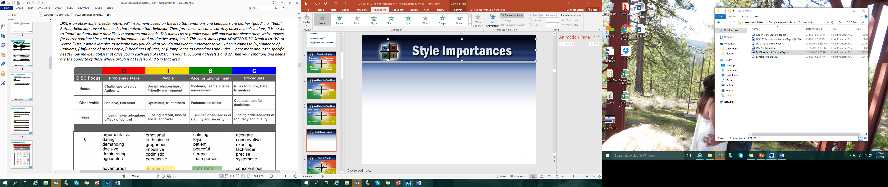
Style Indicators
DISC examines our observable behavior driven by on our needs and fears. Each style has specific indicators.
Notes:
DISC examines our observable behavior driven by our needs and fears. Each style has specific indicators. This table shows: • A reminder of the DISC focus of each style • The Needs of each style • A reminder of the observable behaviors • The Fears of each style
Using the needs and fears, you can design conversations and interactions that are mutually beneficial by meeting the needs and alleviate the fears of the other person. Remember to use this for good and not evil!

Slide 15
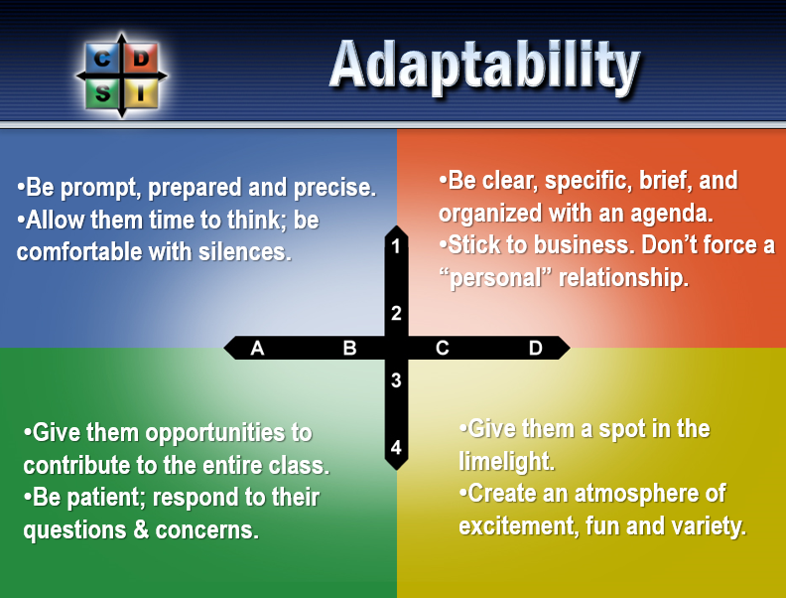
Notes:
By making the choice to be aware and adapt, we can work on the best ways to strengthen our communication with each. Remember to consider any challenges that may arise in regard to pace and priority and be sure you are on the same page when it comes to goals, whether task or people focused.
Review slide

Slide 16
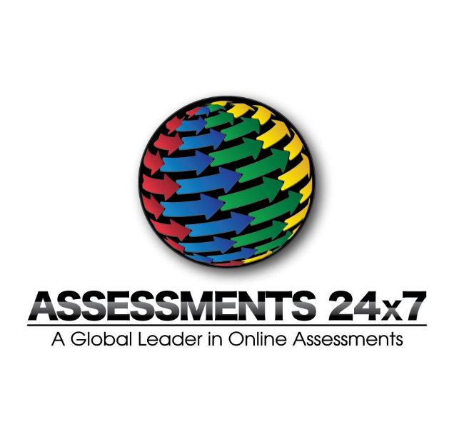
DISC Report
Notes:
Before we transition into our debrief portion where we look specifically at your DISC report, I would like to remind you of 2 things –
• Remember The Platinum Rule ® - practice identifying behavioral styles and adapting for improved communication
• Adapting our style is not always easy! It may take some time, or seem very difficult. Give it time, practice, and patience.
Review report as desired

Slide 17
Break time

Slide 18
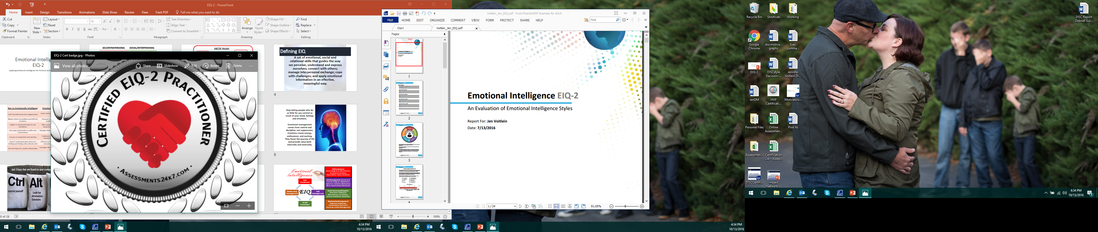
Emotional Intelligence EIQ-2
Applying Emotional Intelligence for Greater Personal and Professional Success

Slide 19
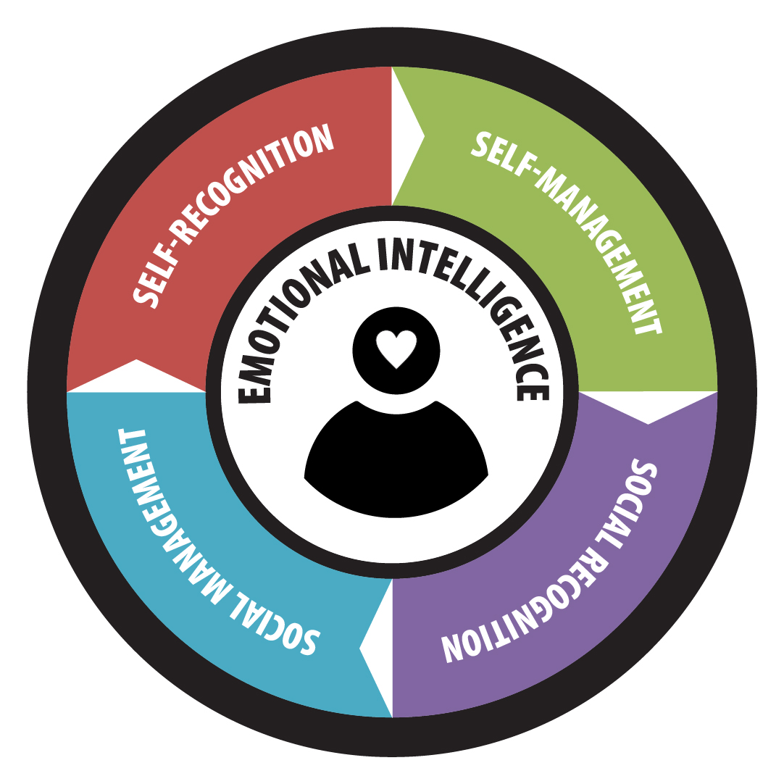
Emotional Intelligence
The ability to:
perceive emotions
access and generate emotions to assist thought
understand emotions and emotional knowledge
reflectively regulate emotions to promote emotional and intellectual growth
Emotional Intelligence is a way of recognizing, understanding and choosing how we think, feel and act, shaping our understanding of ourselves and our interactions with others.
Notes:
Emotional intelligence focuses on self and relationships. Intrapersonal awareness and management deal with recognizing, acknowledging and working with emotions. Interpersonal relationships deal with empathy, connection and social skills. These are known as soft skills but tend to be more meaningful in performance.

Slide 20
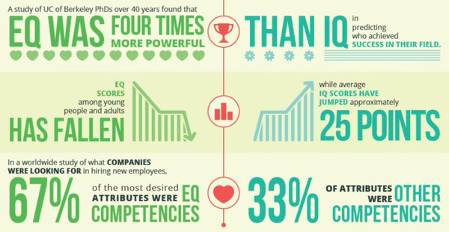
Why Does it Matter?
Notes:
Based on this information, EQ is an influential contributor to personal and professional success and yet there is a lack of support for learning and growth in this area.

Slide 21
Why Does it Matter?
Notes:
Based on this information, EQ is an influential contributor to personal and professional success and yet there is a lack of support for learning and growth in this area.

Slide 22
Why Does it Matter?
Notes:
Based on this information, EQ is an influential contributor to personal and professional success and yet there is a lack of support for learning and growth in this area.

Slide 23
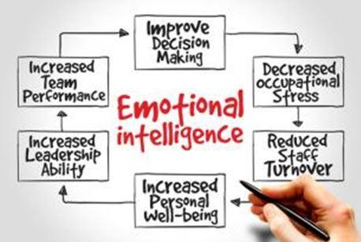
EIQ can be measured as difference directly associated with personal and professional success in many areas, including:
Communication
Decision-Making
Leadership
Sales
Teamwork & Team Performance
Productivity
Relationship Satisfaction
Customer Service
Conflict Management
Overall Effectiveness
Why Does it Matter?
Notes:
Furthermore, there are so many benefits to having a strong EIQ.

Slide 24
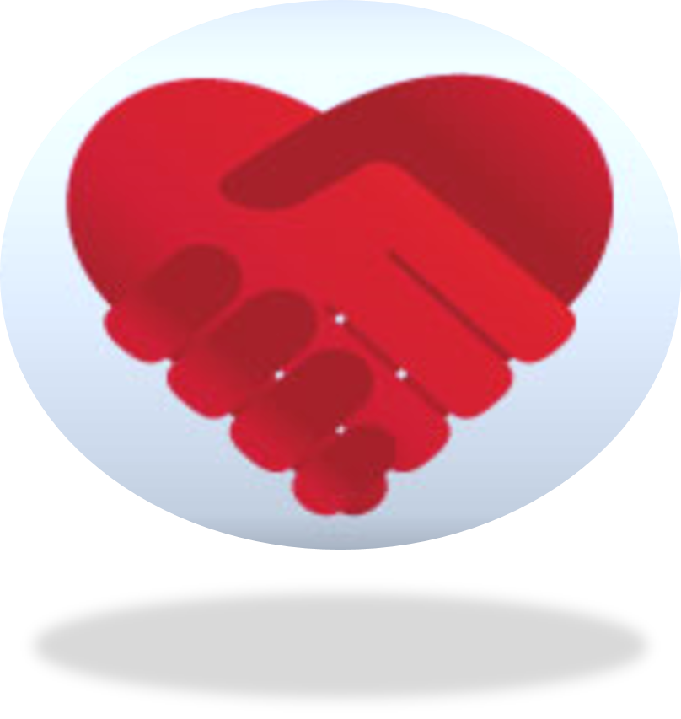
Table Discussion
Communication
Decision-Making
Leadership
Sales
Teamwork & Team Performance
Productivity
Relationship Satisfaction
Customer Service
Conflict Management
As a table group:
Define success in 2 of the areas based on your understanding of emotional intelligence
Notes:
What does success look like in each of these areas, when emotional intelligence is High?

Slide 25
Tips on Low and High EQ
Low Emotional Intelligence
High Emotional Intelligence
Feels misunderstood and unappreciated
Blames others for problems and difficult situations
Subject to emotional outbursts and moodiness
Gets angry and hostile in conflict and confrontation
Focuses on competition and winning
Doesn’t understand what others are thinking and feeling unless directly told
Has few long-term, quality relationships
Learns and adapts to audiences and situations
Assumes responsibility and fixes problems (creatively)
Takes control of performance and productivity; Self-disciplined
Manages feelings for positive, win/win resolution
Emphasizes abundance thinking, teamwork and collaboration
Effective at reading both verbal and nonverbal cues for empathy
Leverages relationships for mutual gain and growth
Notes:
Review slide.

Slide 26
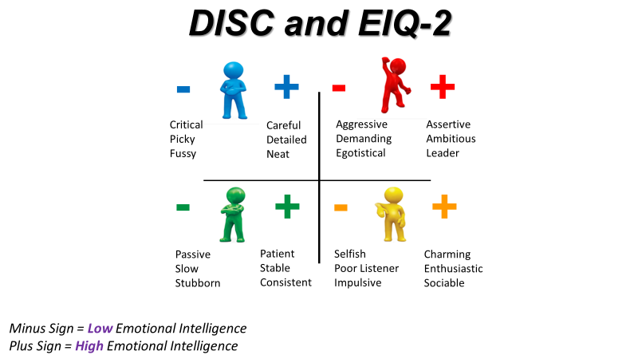
Notes:
This slides shows why it is so important to consider Emotional Intelligence and our DISC style together. If DISC is the expression in behavior, then emotional intelligence creates the impact on others, based on the way we express it. And there is a difference!
Review slide.

Slide 27
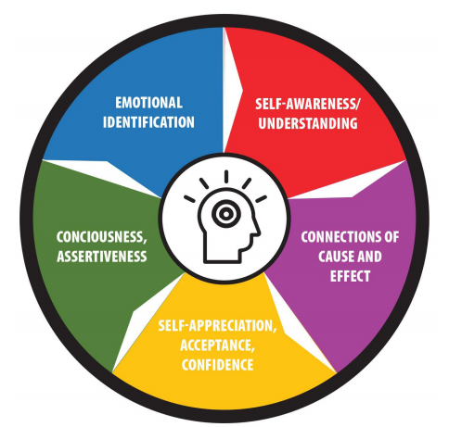
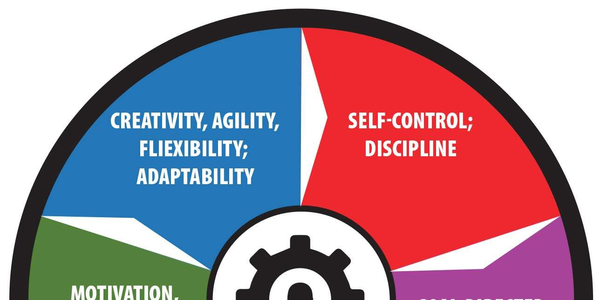
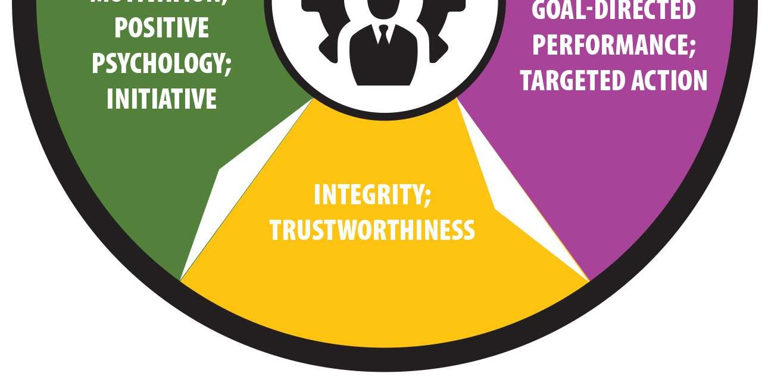
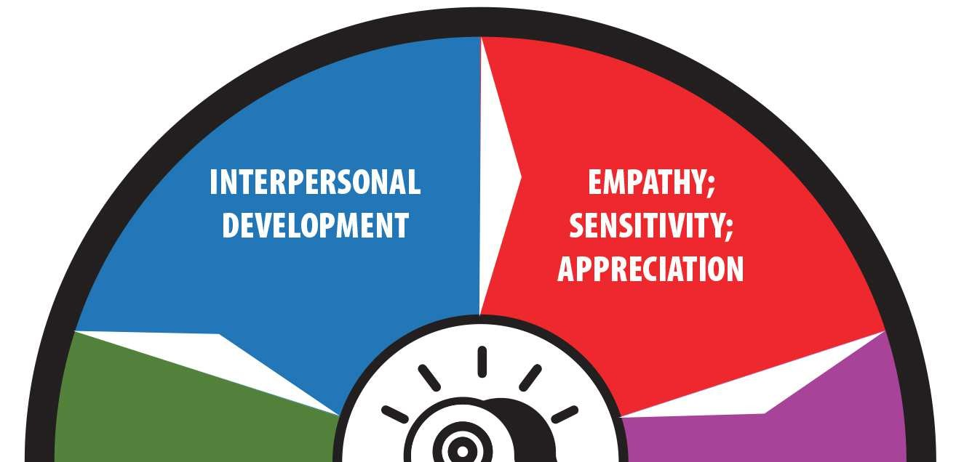
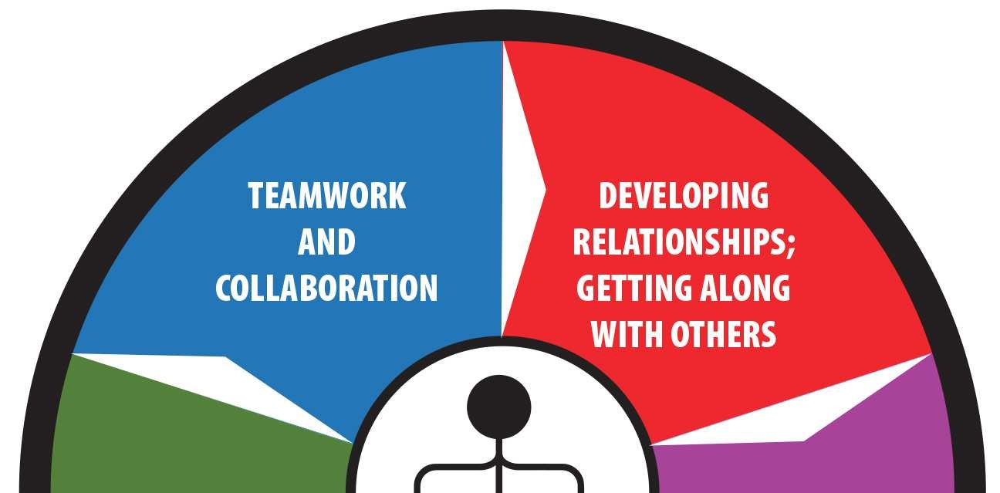
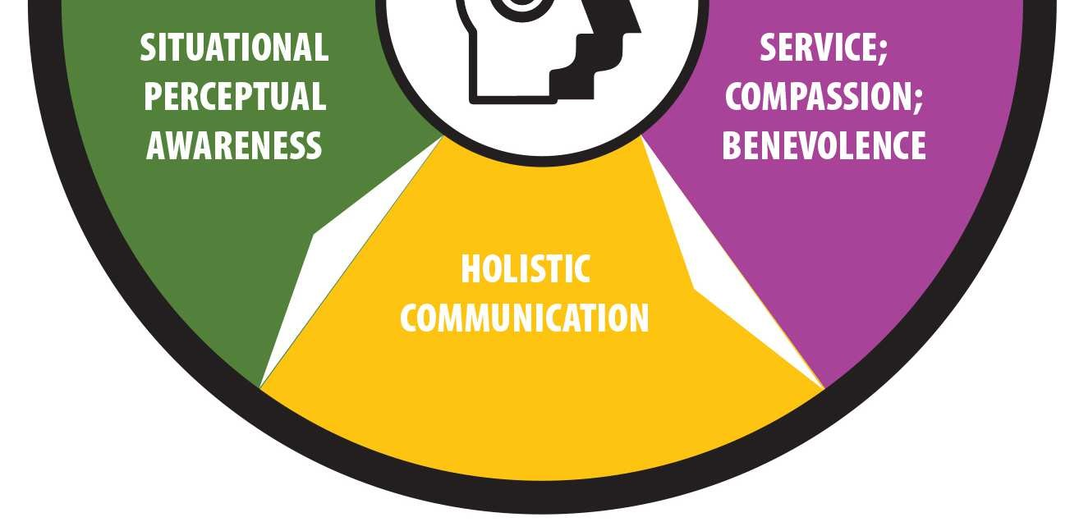
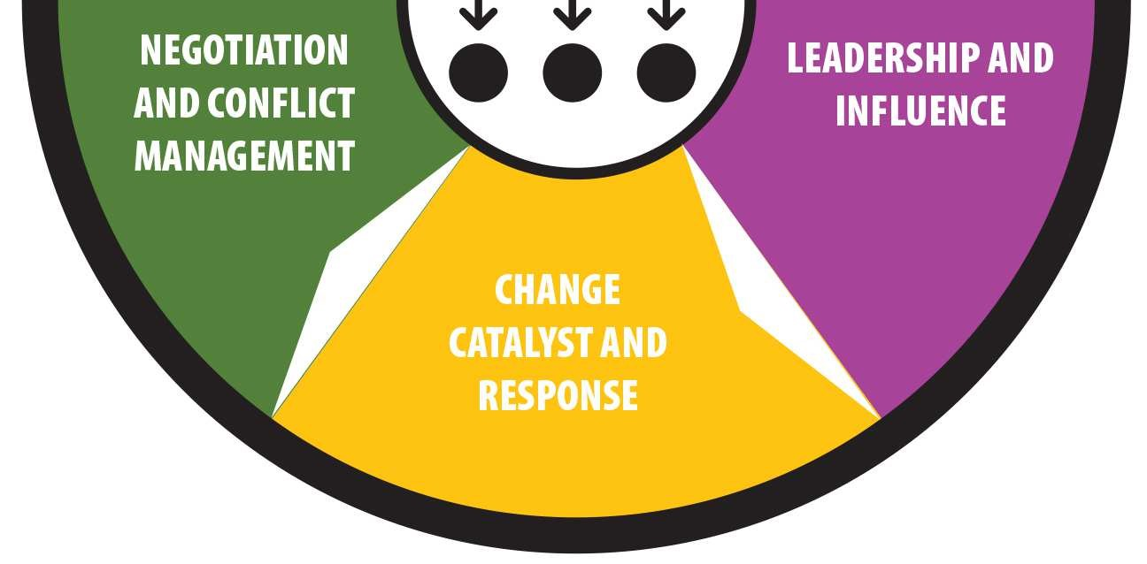
Intra-Personal
Self-Assurance
Emotional Identification
Discipline & Control
Self-Regulation
Problem Solving
Creativity & Responsiveness
Inter-Personal
Communication Styles
Result Orientation
Conflict Resolution
Teamwork
Leadership
Influence
Self-Recognition
Social Recognition
Self-Management
Social Management
Notes:
In EIQ – we examine both intra and inter personal relationship of recognition or awareness and management. Each of these elements works together to create our overall EIQ and are all interrelated; what affects one area can also affect the other areas.
Let’s take a closer look at each of these quotients. Keep in mind, you have much more information on them in your report as well.
As you look at the scores in the report, remember that we are measuring two things in each of these quotients. Your scores tells us information about you CAPABILITY and your ATTENTIVENESS in each of these areas. If your score is high, it is likely that you have both capability and attention in this area, though the score alone is not the only indicator. As you review each of these areas, and the scores in each of the sub-categories, be mindful and run a personal inventory on whether that score is an accurate reflection based on your SKILL and CAPABILITY in this area, AND the amount of ATTENTION and FOCUS you are putting into it.

Slide 28
Self Recognition
Self Awareness/ Understanding
Connection of Cause and Effect
Self Appreciation, Acceptance and Confidence
Consciousness, Assertiveness
Emotional Identification
Self-recognition reflects intrapersonal communication. It is foundational to social awareness and self-management.
Notes:
Factors include: Personality style, learning style, mental attitude, comfort and discomfort, strengths and weaknesses, biofeedback, self-acceptance, self-esteem, temperament, tension and stress levels, spirituality and conscience.
Self Awareness/Understanding: a conscious, deliberate reflection on personal identity, image, feelings, motives, desires and how these are associated with perceptions of self in the context of various situations. Empathy and understanding of self. Knowing why emotions occur.
Connections of Cause and Effect: recognition of the impact and consequence of behaviors on feelings and moods; separating external and internal factors effecting emotions. Knowing how feelings relate to performance.
Self Appreciation, Acceptance and Confidence: development of self esteem; personal worth and value; and coming to grips with personal attributes. Recognizing personal strengths, weaknesses, and limitations. Operating with realistic self assurance.
Consciousness, Assertiveness: intentional establishment of personal boundaries and appropriate limits; choosing a path that expresses self worth through personal care and outward presentation
(presence).
Emotional Identification: ability to identify and name personal feelings; vocabulary and definition of emotions allowing choices, responses and performance; effective reflection on intrapersonal information.
In your assessment report, you’ll have an individual score in each of these factors so you can see very clearly which areas are leading to you greatest success and which are potentially contributing to limitations for you.

Slide 29
Building Self-Recognition
Accept emotions without judgment.
Self monitor; take time to reflect and review.
Associate emotions with attitudes and consequences.
Accept advice without becoming defensive.
Develop greater mental security - feeling safe and comfortable with who you are regardless of outside challenges and threats.
Analyze strengths and weaknesses fairly and with an eye toward growth.
Create realistic personal expectations.
Cultivate positive mindset and optimism.
Connect with positive, supportive people.
Generate expectations of causes and consequences.
Notes:
Review slide

Slide 31
Reflection
Individually:
Consider areas of your life that reflect high or low emotional intelligence. What is currently happening that makes you think so?
Notes:
What is my level of emotional intelligence and how is that affecting me right now?

Slide 32
Social Recognition
Empathy, sensitivity, appreciation
Service, compassion, benevolence
Holistic Communication
Situational Perceptual Awareness
Interpersonal Development
Social-recognition reflects awareness and consideration of the feelings and responses of others. The ability to empathize and maintain sensitivity to the moods and emotions of others allows for superior connection.
Notes:
Factors included: Empathy, Understanding/compassion, Sensitivity/thoughtfulness, Appreciation, Holistic communication, Rapport, Connection and
Relationships
Empathy; Sensitivity; Appreciation: understanding others; accurately picking up emotional cues from communication (including words, tone and nonverbal signals); managing direct and indirect feedback effectively; being attentive, sensitive, aware and appreciative of the emotional signals of others.
Service; Compassion; Benevolence: operating with a sense of contribution; aiding, helping, coaching and developing others; giving; operating constructively to contribute to the emotional states and benefits of others; recognizing needs, wants and desires; relating to alternative thoughts, perceptions and perspectives.
Holistic Communication: the abilities to effectively send and receive information including emotional content; listening; engaging and connecting with others; sending and receiving verbal and nonverbal signals constructively.
Situational Perceptual Awareness: recognizing and processing dynamic, shifting emotional data; communicating attention, focus, awareness and connection; adapting to situational variables and changes; understanding which factors count, how much and responding with reasonable behavior.
Interpersonal Development: growing and nurturing constructive connections; setting the tone for long term depth and breadth in relationships; working with quality in personal and professional relations; having resonance and rapport.
Remember - you’ll have an individual score in each of these factors so you can see very clearly which areas are leading to you greatest success and which are potentially contributing to limitations for you.

Slide 33
Building Social-Recognition
Actively look for opportunities to help others and promote their agendas.
Actively listen; pay attention.
Take in feedback and critiques from others.
Become more interested and enthusiastic about others.
Follow through on promises and commitments.
Create opportunities to connect.
Be positive and open when responding to new people and ideas.
Pay attention to both head and heart messages.
Notes:
Review slide

Slide 34
Practice Social-Recognition
Identify one thing you would like to work on in your EIQ
Tell your partner what you are planning to working on, and allow them the opportunity to listen, connect, and offer suggestions and encouragement

Slide 35
Self Management
Self-control, discipline
Goal-directed performance, targeted action
Integrity, trustworthiness
Motivation, positive psychology, initiative
Creativity, agility, flexibility, adaptability
Self-management measures self-evaluation coupled with self-regulation, to control and harness feelings that impact the ability to achieve personal objectives.
Notes:
Factors include: Restraint, Discipline, Control, Resolve, Direction/purpose, Emotional management, Flexibility, Enthusiasm/excitement
Satisfaction, happiness and contentment are results of self management.
Self Control; Discipline: effectively handling impulses; maintaining composure while experiencing stressful, trying emotions; managing preparation and performance; actively choosing paths; self directing; the ability to emotionally persist to achieve strategic objectives.
Goal Directed Performance; Targeted Action: focus to achieve long term desired goals; emotional tenacity and persistence; drive to choose challenging objectives and assume acceptable risk; staying the course to completion; resilience in the face of obstacles and setbacks; seizing opportunities.
Integrity; Trustworthiness: the ability to work with conscience, ethics and integrity; operating with personal standards, principles and values; being dependable, reliable and authentic; keeping promises and assuming personal responsibility.
Motivation, Positive Psychology; Initiative: self energizing; the ability to be mentally and emotionally engaged; attitude; passion; choosing cause and effect feelings; being responsible for personal success; acting and choosing feelings in accordance with positive emotions, optimism and constructive feelings; limiting negative emotions, patterns and spirals.
Creativity, Agility, Flexibility; Adaptability: coping with change, transition and development; adjusting to situations, relationships and feelings; handling curiosity and imagination to create, discover and explore opportunities; innovation for progress; cognitive and emotional shifts to augment and manage change; the abilities to problem solve and 'think outside the box.’
Remember - you’ll have an individual score in each of these factors so you can see very clearly which areas are leading to you greatest success and which are potentially contributing to limitations for you.

Slide 36
Building Self-Management
Set and monitor a specific course and path for each day.
Act with focus and intensity.
Define a clear path to desired goals.
Exercise discipline and self control in both short and long term projects.
Take time to evaluate and critique personal performance.
Identify gaps in desired returns and improve plans to achieve better results.
Avoid fatigue and burnout.
Stick with a concrete, articulated agenda.
Remain accountable for your actions.
Notes:
Review Slide

Slide 37
Practice Self Management
What is your next goal?
Take a few minutes to design your next goal
Find a new partner and tell them about your goal while practicing being excited, motivating, and creating positive energy about your goal

Slide 38
Social Management
Developing relationships, getting along with others
Leadership and influence
Change catalyst and response
Negotiation and conflict management
Teamwork and collaboration
Social (relationship) management includes interpersonal skills and focuses intelligence on generating results. Social intelligence fosters collaboration and connection.
Notes:
Factors include: Directing, Encouragement, Building friendships, Supporting, Social poise, Warmth, Team results, Collaboration
Developing Relationships; Getting Along with Others: cultivating, nurturing and maintaining long term personal and professional relationships; having quality connections and friendships.
Leadership and Influence: operating with warmth, likability, presence, charisma, and approachability; paying attention and focusing on results; being involved, engaging, passionate and powerful; showing deliberate persuasion; delivering solutions and success to others and to groups; partnering for targeted outcomes.
Change Catalyst and Response: recognizing the need for change and championing action; develop interpersonal skills and abilities; initiating growth and progress on individual, team and organizational levels; facilitating maturity and success. Focusing on eustress and positive outcomes.
Negotiation and Conflict Management: bargains with abundance thinking for mutual gains; copes with conflict through positive proactive and reactive techniques; effectively deals with difficult people and situations; creates unity, balance and gain.
Teamwork and Collaboration: builds bonds; transforms groups into teams; fosters unified, engaged effort; generates collaboration, cooperation, participation and high quality results; nurtures spirit de corps and the ability to develop synergy. Interpersonal emotional effectiveness.

Slide 39
Building Social-Management
Take an active interest in others and their agendas.
Develop persuasion and rapport.
Be assertive, engaged, enthusiastic and involved with others.
Maintain poise and calmness.
Look for positive, constructive answers that help everyone improve.
Seek out opportunities to work and collaborate with others.
Reach out and be available to others.
Enjoy listening to the ambitions of others and offer praise.
Develop quality relationships and friendships.
Notes:
Review slide

Slide 40
Practice Social Management
As a table, create an acronym for the word GOALS that outlines:
What do we want to be known for as a team?
What do we want to accomplish in the coming months?

Slide 41
Wrap-up Discussion
As a group:
What is the most important quotient measured in Emotional Intelligence and why?
Notes:
This can be done in several ways like:
assign each of the 4 quotients to groups, and have that group outline and defend why their quotient is the most important
OR
2. As the whole or table group to debate/discuss which of the 4 is most important and why?
Allow time for sharing.

Slide 42
EIQ-2 Report
Notes:
Review reports as desired

Slide 43
DISC and EIQ-2
Notes:
Now let’s look a little deeper at how the ideas of DISC and EIQ come together.

Slide 44




All elements of EIQ are present for every DISC style; how they are expressed and managed is specific to the style.
Self-Recognition
DOMINANCE
Self-Management
INFLUENCE
Social Recognition
STEADINESS
Social Management
CONSCIENTIOUS
Notes:
Review slide

Slide 45
Comfort and discomfort
Strengths and challenges
Self acceptance
Tension and stress levels
Biofeedback
Spirituality
Conscience
Self Recognition/Awareness
 | Self-Awareness & Understanding | Connections of Cause & Effect | Self-Esteem & Confidence | Assertiveness & Aggression | Emotional Identification
Dominance | Low | Low | Task: High Interpersonal: Low | High | Low
Influence | Moderate | Low | Task: Low Interpersonal: High | Moderate | Low to Moderate
Steadiness | High | High | Task: Moderate Interpersonal: Moderate | Low | Moderate
Conscientious | Low | Moderate | Task: Moderate Interpersonal: Low | Low | Low
Evaluating the five areas of Self-Recognition and DISC Styles (see Self-Recognition Wheel in report for definitions)
Notes:
This table shows us what we would expect scores to look like for each of the sub-categories, based on each DISC style. You can use this to evaluate yourself in comparison, but also and more importantly, look at how you can use this information to grow your capability and attentiveness in each of the areas to be sure your expression of DISC is as you intend.
Self-Recognition subscores

Slide 46
Social Recognition/Awareness
Understanding others
Nurturing and helping
Gratitude
Connecting and engaging
Relationships
Adapting
Communicating
 | Empathy, Sensitivity, Appreciation | Service, Compassion, Benevolence | Holistic Communication | Situational Perceptual Awareness | Interpersonal Development
Dominance | Low | Low | Sending: High Receiving: Low | Verbal: High Nonverbal: Low | Low
Influence | Moderate | High | Sending: High Receiving: Low | Verbal & Nonverbal: Low to Moderate | Moderate to High
Steadiness | High | High | Sending: Low Receiving: High | Verbal: Low Nonverbal: High | Moderate
Conscientious | Low | Moderate | Sending: Low Receiving: Low | Verbal: Low Nonverbal: Low | Low
Evaluating the five areas of Social-Recognition and DISC Style (see Social-Recognition Wheel in report for definitions)
Notes:
This table shows us what we would expect scores to look like for each of the sub-categories, based on each DISC style. You can use this to evaluate yourself in comparison, but also and more importantly, look at how you can use this information to grow your capability and attentiveness in each of the areas to be sure your expression of DISC is as you intend.
Social Recognition subscores

Slide 47
Self Management
Restraint and control
Determination
Direction and purpose
Emotional management
Flexibility
Enthusiasm and excitement
 | Self-Control & Discipline | Goal Orientation | Integrity & Trustworthy | Motivation, Initiative, Optimism | Creativity, Agility, Adaptability
Dominance | Task: High Interpersonal: Low | High | A major element of Emotional Intelligence, not related to D style | Task: High Interpersonal: Low | Task: High Interpersonal: Low
Influence | Task: Low Interpersonal: Low | Low | A major element of Emotional Intelligence, not related to I style | Task: Low Interpersonal: High | Task: Low Interpersonal: High
Steadiness | Task: High Interpersonal: High | Moderate | A major element of Emotional Intelligence, not related to S style | Task: High Interpersonal: High | Task: Low Interpersonal: Low
Conscientious | Task: High Interpersonal: High | Moderate | A major element of Emotional Intelligence, not related to C style | Task: High Interpersonal: Low | Task: Moderate Interpersonal: Moderate
Evaluating the five areas of Self-Management and DISC Style (see Self-Management Wheel in report for definitions)
Notes:
This table shows us what we would expect scores to look like for each of the sub-categories, based on each DISC style. You can use this to evaluate yourself in comparison, but also and more importantly, look at how you can use this information to grow your capability and attentiveness in each of the areas to be sure your expression of DISC is as you intend.
Self Management subscores

Slide 48
Social Management
Directing
Encouraging
Seeking team results
Poise and warmth
Supporting
Collaborating
 | Getting Along with Others | Leadership and Influence | Change Catalyst & Response | Negotiation and Conflict Resolution | Teamwork and Collaboration
Dominance | Low Emotional Rapport and Resonance | Task Oriented: High Team Development: Low | Task Oriented: High Team Development: Low | Strategy and Tactics: High Interpersonal: Low | Low
Influence | High Emotional Rapport and Resonance | Task Oriented: Low Team Development: High | Task Oriented: Low Team Development: High | Strategy and Tactics: Low Interpersonal: High | High
Steadiness | High Emotional Rapport and Resonance | Task Oriented: Low Team Development: High | Task Oriented: Moderate Team Development: Moderate | Strategy and Tactics: Moderate Interpersonal: High | Moderate
Conscientious | Low Emotional Rapport and Resonance | Task Oriented: High Team Development: Low | Task Oriented: High Team Development: Low | Strategy and Tactics: Low Interpersonal: Low | Low
Evaluating the five areas of Social-Management and DISC Style (see Social-Management Wheel in report for definitions)
Notes:
This table shows us what we would expect scores to look like for each of the sub-categories, based on each DISC style. You can use this to evaluate yourself in comparison, but also and more importantly, look at how you can use this information to grow your capability and attentiveness in each of the areas to be sure your expression of DISC is as you intend.
Social Management Subscores

Slide 49
Summary
Notes:
While DISC is easy to apply and see immediate results and changes in our interactions, remember that building emotional intelligence takes practice!
Take it one day at a time, and focus on small changes that you can sustain to strengthen your EIQ. You will see changes, though they may be gradual. Stick with it, and know that your learning and practice is a continual growth process.

